Slide 1
Design Presentation: Spark for Data Science
Owner: Sean Norman
CSA19P | 1 of 2
Session Day/Time: | Day 3, Model, Manage & Secure: 08:00 – 08:45 | Presenters/SMEs: | Presenter: John Doe SME(s): John Doe; Jane Doe
Virtual Format and Software: | Presentation: Single Speaker Presenter, ppt slide presentation, live virtual broadcast via Teams, chat enabled and moderated
Cohort / Breakout Mgmt | No cohorts / breakout activities during this session
Objective of Session: | As a result of attending this, attendees will better be able to…
Existing Sources: | <link to any supporting content sources (if any)>
Learner Content: | <Link to draft ppt slide deck and any other materials that the attendees would be seeing or using as part of this session>
Presenter/ SME Guide Content: | <Link to any supporting materials that are just for the presenter and/or supporting SMEs>
Required Homework + name of session for HW review: | No homework or pre-required content needed for this session

Slide 2
Design Presentation: Spark for Data Science
Owner: Sean Norman
CSA19P | 2 of 2
Session Flow and Detailed Agenda |  | Presenter/SME: | Time
Prework | No attendee pre-work needed for this session | N/A | N/A
Session Introduction | Set context for when this process takes place | <presenter> | 3 mins
Body of the session / discussion, activities, Q&A... | Creating spark pool, importing libs Using Spark to query SQL Pool Notebook capabilities Azure Machine Learning Primer Functionality overview Architecture Synapse job service Spark instances Spark pools Polybase Code-behind experience Notebooks on files in storage Library management - Python Spark ML Microsoft ML for Spark | <presenter> | 25 mins
Session Closing / Homework | Go to break Review timing for break, remind audience to stay signed into the meeting, when session will resume, and what they will be doing next. (Data Loading & Data Lake Organization) | <presenter> | 2 mins

Slide 3
Spark for Data Science
CSA19P

Slide 4
Topics Covered
Creating spark pool, importing libs Using Spark to query SQL Pool Notebook capabilities Azure Machine Learning Primer Functionality overview Architecture Synapse job service Spark instances Spark pools Polybase Code-behind experience Notebooks on files in storage Library management - Python Spark ML Microsoft ML for Spark

Slide 5

Agenda sample 1
Agenda Slide Option #1
1 First Agenda Item
Here we have an example of what the agenda item would look like.
4 Third Agenda Item
Here we have an example of what the agenda item would look like.
2 Second Agenda Item
Here we have an example of what the agenda item would look like.
5 Fifth Agenda Item
Here we have an example of what the agenda item would look like.
3 Second Agenda Item
Here we have an example of what the agenda item would look like.
6 Sixth Agenda Item
Here we have an example of what the agenda item would look like.

Slide 6
Apache Spark Overview

Slide 7
Spark in Azure Synapse Analytics - Overview

Slide 8
Spark in Azure Synapse Analytics - Architecture
Spark instances Spark pools Polybase

Slide 9
Spark Pools - Creating

Slide 10
Spark Pools - Configuring
Idle timeout

Slide 11
Spark Pools – Library management

Slide 12
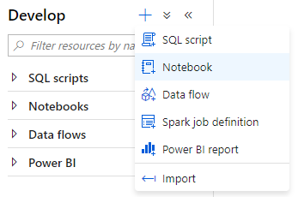
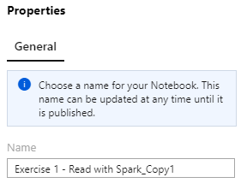
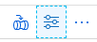
Spark Pools – Notebook capabilities
Creating a new notebook
Naming the notebook

Slide 13
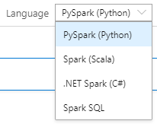
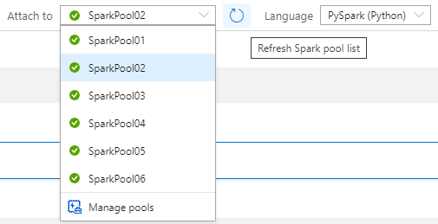
Spark Pools – Notebook capabilities
Language selection
Attach to Spark Pool / Refresh list

Slide 14
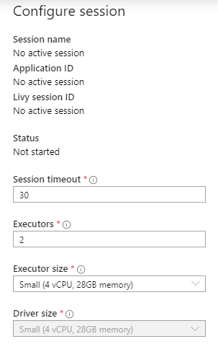
Spark Pools – Notebook capabilities
Session timeout
Executors – quantity & size

Slide 15
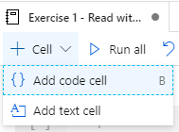
Spark Pools – Notebook capabilities
Add code cell
Add text cell
Support for GitHub flavored markdown

Slide 16
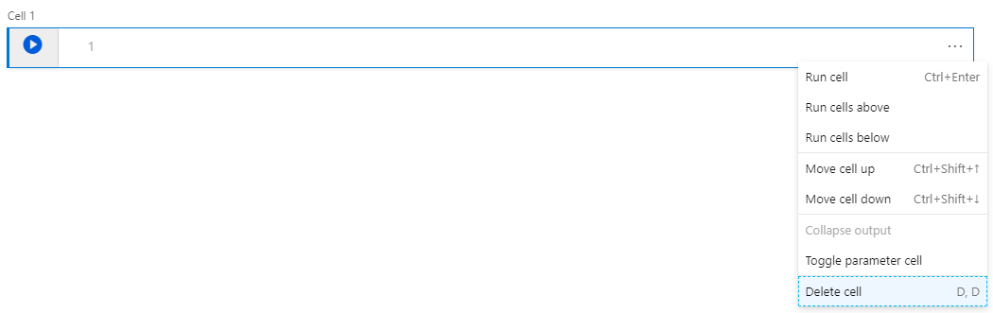
Spark Pools – Notebook capabilities
Remove cell

Slide 17
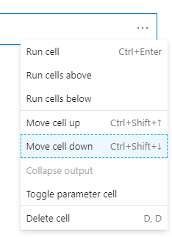
Spark Pools – Notebook capabilities
Adjust cell order

Slide 18
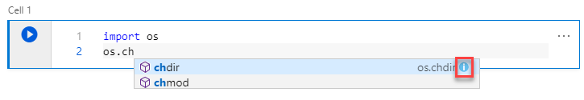
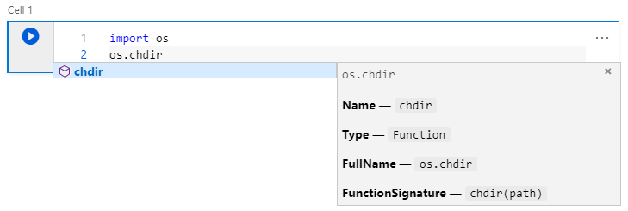
Spark Pools – Notebook capabilities
Statement completion
Ctrl + Space
Inline documentation

Slide 19
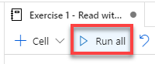
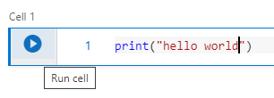
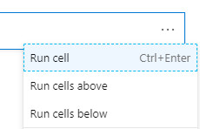
Spark Pools – Notebook capabilities
Run cells

Slide 20
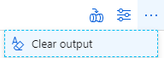
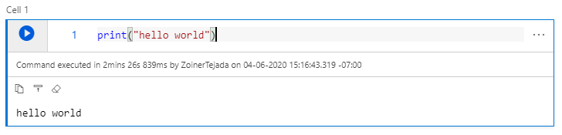
Spark Pools – Notebook capabilities
Managing cell output
Copy, collapse and clear

Slide 21
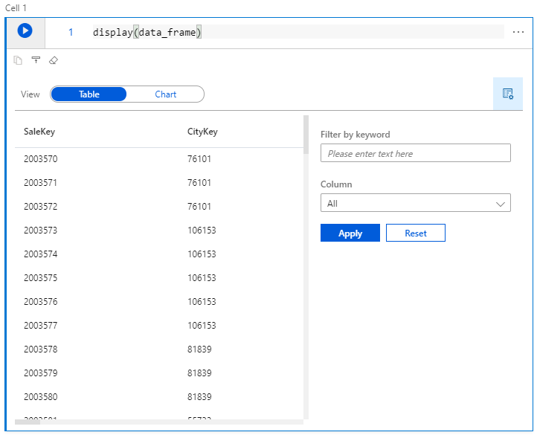
Spark Pools – Notebook capabilities
Viewing DataFrames as tables

Slide 22
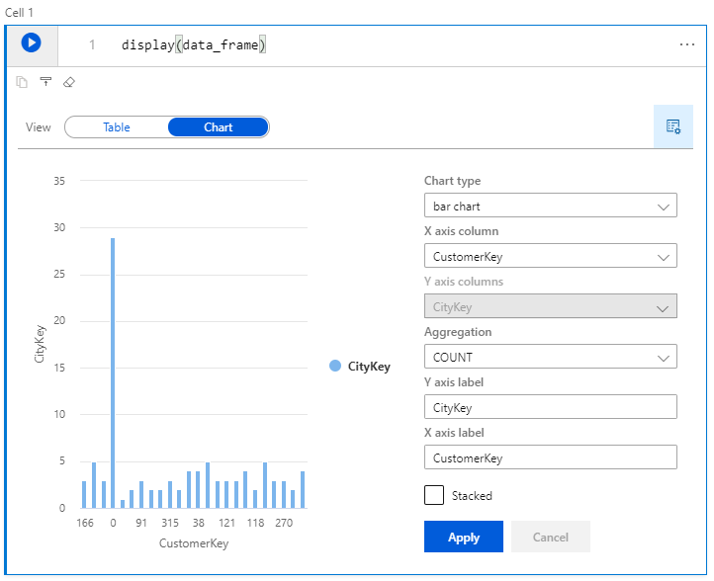
Spark Pools – Notebook capabilities
Viewing DataFrames as charts

Slide 23
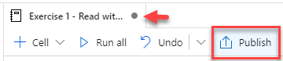
Spark Pools – Notebook capabilities
Saving (Publishing)

Slide 24
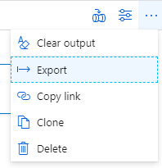

Spark Pools – Notebook capabilities
Exporting

Slide 25
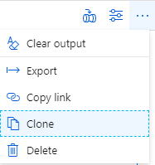
Spark Pools – Notebook capabilities
Duplicating a notebook

Slide 26
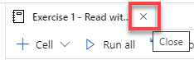
Spark Pools – Notebook capabilities
Detaching a notebook from a Spark Pool

Slide 27
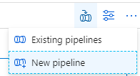
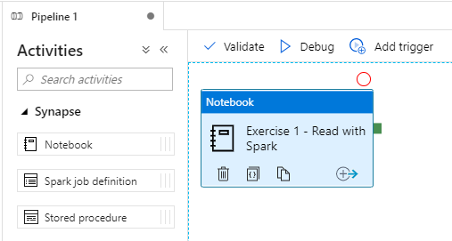
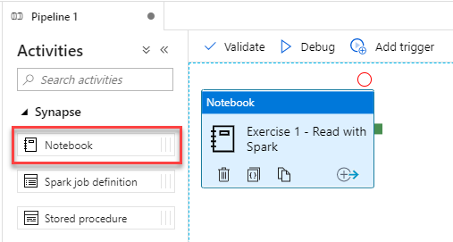
Spark Pools – Notebook capabilities
Using a notebook to create a new pipeline

Slide 28
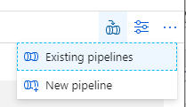
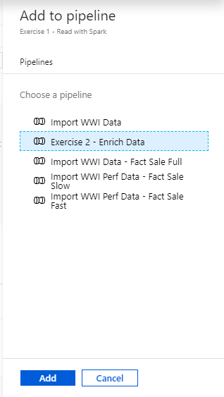
Spark Pools – Notebook capabilities
Using a notebook in an existing pipeline

Slide 29
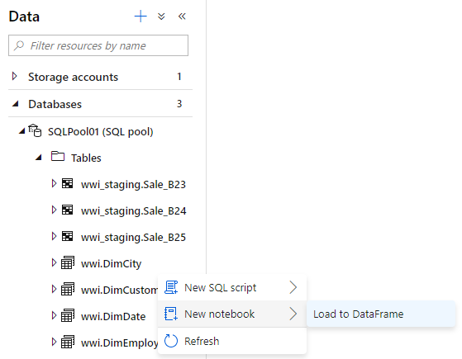
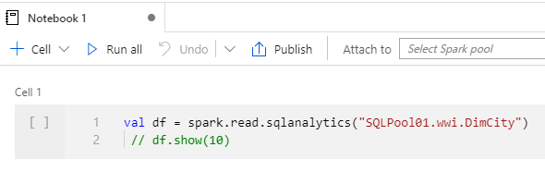
Spark Pools – Querying SQL Pools using notebooks
Loading a SQL Pool table to a DataFrame

Slide 30
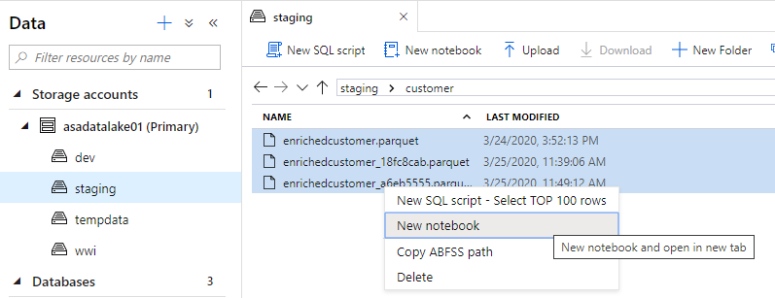
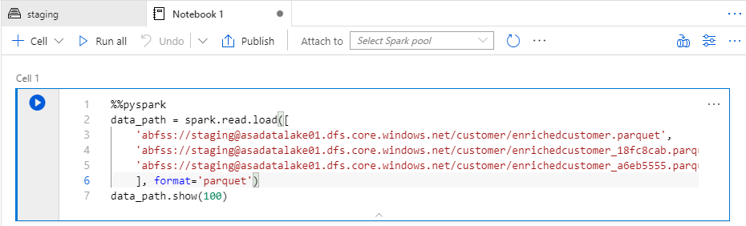
Files – Querying using notebooks
Loading Parquet files from ADLS into DataFrame

Slide 31
Synapse Job Service

Slide 32
Apache Spark ML

Slide 33
Microsoft ML for Spark

Slide 34
Making predictions with T-SQL
Train
Package
Register
Predict

Slide 35
ONNX

Slide 36
Azure Machine Learning Primer

Slide 37
Thank You slide
Thank you

Slide 39

Icon library / A
These are monoline icons. You can change the color outline by clicking on the icon then selecting the desired color in “Shape Outline” found under the “Home” tab.
AMBITIONS*
Productivity and business processes | Intelligent cloud | More personal computing | Ambitions
VISION*
Mobile-first | Cloud-first
DIGITAL TRANSFORMATION*
Engage customers | Empower employees | Optimize operations | Transform products | Digital transformation
SOLUTION AREAS*
Modern workplace | Business applications | Apps & infrastructure | Data & AI | Gaming
*These icons (with the exception of the Gaming icon), are to be used ONLY for the purposes stated above. They are standardized icons and are used to identify the Microsoft ambitions, vision, digital transformation and solution areas.

Slide 40
Icon library / A
ACTIONS
Hand | Finger inking, swipe, drag | Touch, press, finger | Touchscreen, interactive, tablet | Give, donate | Commitment, partner, customer, handshake, trust | Like, yes, thumbs up, approve | Dislike, no, disapprove, thumbs down | Like, dislike, preference, vote | Eye, see, look, view, visibility | Talk, chat, conversation | Brush, paint, brushstroke
Call, phone, talk, answer | Hang up, end call | Scissors, cut, trim | Trash, garbage, rubbish, delete | Attach, attachment, paperclip | Save, floppy disk | Crop | Trim video, crop video | Pin, remember, thumbtack | Copy, multiple files, duplicate | Magnifying glass, search | Zoom
Repair, fix, maintenance, gear, workaround | Surface pen, inking | Send, email | Star rating, rate | Information | Alert, warning, danger | Check, approve, completed | Check, approve, completed | Remove, not allowed, illegal, delete | Plus, add | Math, compute | Percent, fraction
Question, help, ask, inquire | Embed | Share | Archive | Battery, power, energy | - | - | - | - | - | - | -
- | - | - | - | - | - | - | - | - | - | - | -
- | - | - | - | - | - | - | - | - | - | - | -

Slide 41
Icon library / A
ARROWS
Arrow, forward | Full screen, expand, diagonal, stretch | Decrease, shrink, focus, compress | Expand, grow, enlarge | Bidirectional, switch, change direction | Bidirectional, switch, direction | Growth, market, improve, increase | Download | Insert, decrease, drop | Next page, turn page, | Move, shift, relocate | Shrink, compress, swipe, push, wipe
Expand, enlarge, grow | Contract, reduce, shrink | Curved arrow, arc | Undo | Redo | Bidirectional, junction, split, change course | Shuffle, cross path, switch | Cycle, repeat, virtuous cycle, sync, feedback loop | Refresh, loop, continuous, repeat | Roll back, reverse | Refresh, loop, continuous, repeat | Ease of access, accessibility, altered course
Left, back, behind | Right, forward, ahead | Left, back, behind | Right, forward, ahead | Bidirectional, switch, change direction | Right turn, change direction, alter course | Right angle | Share | Morph, transform, change shape, evolve | Replace, compare, transition | Strategy, execution, play, game plan | Strategy, execution, play, game plan
Time, clock, future, time management | History, past, lost time | Revenue, money cycle | Creative process, redraw, creativity, create | Download, install, insert, integrate, minimize | Send, mail, email | Financial, growth, gain | Financial, growth, gain, improvement | - | - | - | -
- | - | - | - | - | - | - | - | - | - | - | -
- | - | - | - | - | - | - | - | - | - | - | -

Slide 42
Icon library / B–C
BUILDINGS
House, home, residence | House, home, residential neighborhood | Apartments, skyscrapers, offices, businesses | Skyscrapers, offices, businesses | City, office, business | Offices, apartments, cityscape, rural | Offices, apartments, cityscape, rural | Warehouse, garage manufacturing | Bank, banking | Courthouse, government, post office, city hall | Factory, manufacturing | Open door, doorway, opportunity
Library, schoolhouse, education | Schoolhouse, education, university, college | - | - | - | - | - | - | - | - | - | -
- | - | - | - | - | - | - | - | - | - | - | -
CHARTS / GRAPHS
Line chart, growth, point chart | Scatter chart, scatter graph | Line chart, line graph | Line chart, growth, gain | Financial report, financial growth | Line chart, growth, gain | Relationship, connection, network, collaboration | Bracket, connection, network, collaboration | Bracket, organization, top down | Bar chart, bar graph, vertical graph | Bar chart, bar graph, horizontal graph | Pie chart, market share
Venn diagram, overlapping circles | - | - | - | - | - | - | - | - | - | - | -

Slide 43
Icon library / C
CLOUD / CONNECTIVITY
Cloud | Server, server center, data center, storage | Server security, locked server, data security | Earth, world, planet, globe, internet, online | Global network, internet, connected, world wide web | Online, connected device, global computing | Intelligence, network, web, mesh computing, IOT, internet of things | Signal, transmit, satellite, broadcasting connection | Cell tower, signal, wireless, network tower | Signal, connection, access point network, wireless | Wireless, wifi, signal, signal | Signal strength, wifi connectivity, internet
Bluetooth | Plug in, connection, power cable | Power outlet, plug in | Network, connected devices | Data network, data center, connected data | Printer network, connected devices | Financial data, mobile pay, e-payment | Mobile signal, connected car | Data, binary | Bot | Database | -
- | - | - | - | - | - | - | - | - | - | - | -
- | - | - | - | - | - | - | - | - | - | - | -
COGNITIVE SERVICES / APIs
Vision | Labs | Speech | Knowledge | Language * This icon is a color filled shape and is not outlined. | Search | Cognitive services | - | - | - | - | -

Slide 44
Icon library / D
DEVICES / HARDWARE / SOFTWARE
Cellphone, mobile phone | Mobile video, cellphone video | Approved devices, accepted device | Tablet | Laptop | Desktop, PC | Monitor, screen, display | PC, desktop | Surface Hub, smartboard | Devices | Mobile devices | Touchscreen
Connected monitor, appliance | PC, desktop, workstation, office | Mouse | Flash drive, USB drive, memory stick | Surface pen, inking | Pen, draw, write | Mouse and keyboard, PC tools | Keyboard | Ergonomic keyboard | Remote control, TV remote | Camera, picture, capture | Security camera
Speaker, amplify, music | Calculator | Microsoft Band | Fitbit, smart band, fitness tracker | Smart watch, digital watch | Printer | Scanner | Xbox One controller, Xbox controller, Windows gaming | Xbox One S | Gaming, video games, gamers, game controller | Microsoft HoloLens, augmented reality, AR | Mixed reality, MR
Barcode Scanner | Chat bot | Robot, bot | Bot | Microchip | Server tower, data server | Secure server, secure data, server security | Network, connected | Printer network, connected devices | Data network, server network, connected server | Internet of things, IoT | IoT hub
Data, code, binary | Browser window, website, file explorer | Homepage | Download | Article, app, window | App, window | Website, multiple windows | Post update, article, feed, social media | - | - | - | -
- | - | - | - | - | - | - | - | - | - | - | -

Slide 45
Icon library / E
EDUCATION
Diploma, degree, award, certification | Graduation cap, graduation ceremony | School house, education department, library | Books, reading, library, research | Note taking, homework, studying, research | Pencil, write, note, sketch, edit | Calculator, math | Newspaper, news article | Ribbon, award, reward, accomplishment | Ribbon, award, reward, accomplishment | Flask, beaker, science, chemistry, lab | Maze, puzzle, game
Brain, think, intelligence, smart | Rocket, aeronautics, space exploration | School bus, transportation, commute | Megaphone, speaker, speech, announcement | Drums, music, band, rhythm | Student, boy, teacher, educator | Student, girl, teacher | Student, girl, teacher, educator | Trophy, award, win, competition | Sports, physical education (PE) | - | -
- | - | - | - | - | - | - | - | - | - | - | -
EMAIL / MESSAGING
Mail, email, e-mail, letter, envelope | Send, forward, reply | Return mail | Open message, read | Mail, letter, message, open letter, open mail | Mailbox, send | Mailbox, send, inbox | Post, update, article, social media | Send | Attachment | Chat, talk, conversation, speech | Conversation, chat, talk
Chat thread, texting, Conversation, chat, talk | Chat, talk, conversation, speech | Video call, recorded speech | - | - | - | - | - | - | - | - | -

Slide 46
Icon library / I–M
INDUSTRY SECTORS
Aeronautics | Agriculture | Architecture | Automotive | Construction | Education and research | Energy | Financial services | Healthcare | Engineering and manufacturing | Professional services, media | Sports
Government | Retail | Technology | Media and broadcasting | Travel and transportation | Education | Law | Science | - | - | - | -
MAPS / LOCATION
Globe, global, earth | Globe, global, earth | Navigation, GPS, POI, location, map | Map, location, GPS, directions, navigation | Navigation, GPS, POI, location, map | Map, location, route, quest, destination, journey | Download map, receive location | - | - | - | - | -
MONEY / FINANACE / RETAIL / CONSUMER
Shopping cart, store | Store, bag, shop | Money, dollar sign, cash, revenue, currency | Revenue, financial report, funds | Money, currency, coins | Bank, piggybank | Compare, balance, finance, justice | Credit card, payment, charge, debit card | Mobile payment, digital payment, e-commerce | Barcode scanner | Tag, sale, shopping | Bank

Slide 47
Icon library / O
OBJECTS / TOOLS
Alarm clock | Hourglass, timer | Clock | Flashlight | Funnel | Calculator | Binoculars | Scissors | Camera | Battery, power, charge | Magnifying glass | Tools, screwdriver, wrench
Paperclip | Pushpin, thumbtack | Key | Lock | Safe | Piggybank | Bag | Ballot box, drop box | Box, archive, storage | Present, giftbox | Box, package, shipping | Briefcase, business, work, job
Books, reading | Book, dictionary, novel | Notebook, journal | Pencil | Paintbrush | Paint palette, color | 3D, hologram | Trophy, award | Ribbon, award, reward, accomplishment | Ribbon, award, reward, accomplishment | Flag, finish line | Flags, finish line, win, race
Open door, entryway, opportunity | Clipboard | Megaphone, speaker, speech, announcement | Microphone | CD, music album | Headphones | Headset | Eye glasses | Bike, bicycle | Umbrella, bumbershoot | Balloon, party, celebration | Rocking chair
Remote control | Robotic, manufacturing, mechanical, automation | Forklift | Gears | Traffic cone, construction | Flask, chemistry, science, beaker | Maze, puzzle | Target, bullseye, aim, arrow, dartboard, darts, archery | Games, strategy, chess, poker | Musical instrument, drums | Pizza, food | Lightbulb
- | - | - | - | - | - | - | - | - | - | - | -

Slide 48
Icon library / P
PEOPLE / HEALTH
Person | People, pair, partners | Group, partners, collaboration | Family | People centric, contact | Presenter, speaker | Conversation, talk, chat, message | Tech support, helpline, telemarketer, assistant | Woman, women, girl | Man, men, boy | Woman, women, girl, child | Man, men, boy, child
Identification, ID card, personal information | Identification, ID card, personal information | Directory, address book, contact list | Identification, ID card, personal information | Meeting planner, schedule, appointment | Connect, share, collaborate, switch user | Send, personal information | Receive, download information, people first | Network, collaboration, meeting, manager | Group effort, teamwork | Recognition, award, VIP | Handshake, partner, meeting, agreement, commitment
Location | Speaker, presenter | Bicyclist, rider | Construction worker, under construction, manual labor | Mountain climber, rock climber, | Accessibility, person with a disability | Heart, love | Heart, love, rekindled | Heartbeat, alive, life | Diagnostic, heartbeat, heartrate monitor | Pulse, heartbeat | Health, first-aid, medicine, medical
Laugh, happy, smile, ecstatic, funny | Smile, happy | Sad, frown, upset | Eye, sight, see, eyesight | Brain, thought, thinking, memory, intelligence, idea | - | - | - | - | - | - | -
PHOTO / VIDEO
Gallery, picture, landscape, photo | Gallery, picture, landscape, photo album | Crop | Camera | Recapture | Camera flash, remote camera | Video, film, movie | Video camera | Surveillance camera, security camera | Surveillance camera, security camera | Mobile video, cellphone video | Video call, recorded speech

Slide 49
Icon library / P
PLANTS / TERRAIN / NATURE
Flower, plant, garden | leaf, green, grow | Branch, flora | Tree, woods, forest | Crop, agriculture, wheat, corn | Owl, animals, fauna | Mountains, landscape, mountain range | Cloud, sky | Sun, solar, daylight | Moon, night | Earth, planet, globe, global | Gravity, solar system, universe, planet
PRODUCTIVITY
Update, time, clock, future | Hourglass, timer | Speedometer, slow | Speedometer, RPM | Speedometer, fast, quick | Calendar, schedule | Meeting planner, schedule, appointment | Gears, process, precision, productivity, mechanical | Optical storage, hard disk | Flash drive, USB drive, memory stick | Download, import, insert | Notes, log, journal
Assistant, tech support, help center, call center | News, headlines | Directory, address book, contact list | Directory, logbook | Directory, logbook | Turn page, next page, turn over, fold | Checklist, to do list, tasks | Checklist, to do list, tasks | Checklist, to do list | Checklist, to do list | Bulleted list, checklist | Bulleted list, checklist
File, document, page | Files, documents, pages, duplicate, copy | Files, documents, pages, duplicate, copy | Articles, pages, multipage | Script, ledger, document, contract | Edit | Locked document, secure file | Open folder | File folder | File cabinet, archive | - | -
- | - | - | - | - | - | - | - | - | - | - | -

Slide 50
Icon library / S–T
SECURITY / IDENTITY
Key, lock, secure, encrypt | Locked, protected, safe | Unlocked, unsafe, unprotected | Safe, secure, | Secure server, secure data, server security | Locked document, secure file | Shield, secure | Security, caution, alert, warning, firewall | Fingerprint, NUI, biometrics | Windows Hello, NUI | Surveillance camera, security camera | Surveillance camera, security camera
SOUND / MUSIC
Volume, sound, audio | Mute, sound off | Music, notes | Music, note | Microphone, record | Speaker, sound, audio | Headphones | Headset | CD, music album | Bluetooth | - | -
Play | Play pause | Skip back, previous | Skip forward, next | - | - | - | - | - | - | - | -
TIME / CALENDAR
Time, clock | Time, clock, future | History, past | Hourglass, timer | Stopwatch, timer | Alarm clock | Alarm, bell | Alarm, bell | Calendar | Calendar, schedule | Meeting planner, schedule, appointment | -

Slide 51
Icon library / T–W
TRAVEL / TRANSPORTATION
Train, steam engine, railroad | Train, Amtrak | Train, tram, bullet train | Boat, ship | Airplane, flight, airline | Rocket, space | Bicycle, bike, bicyclist | Bicycle, bike | Truck, mover, semi-truck, shipping | Car, vehicle | Car, vehicle | Smart car, connected car
Earth, globe | Navigation, GPS, POI, location, map | Map, location, GPS, directions, navigation | Navigation, GPS, POI, location, map | Map, location, route, quest, destination, journey | Speedometer, slow | Speedometer, RPM | Speedometer, fast, quick, rapid | - | - | - | -
WEATHER / CLIMATE
Cloud, sky | Thunderstorm, lightning | Lightning bolt, thunder bolt | Cloudy, overcast, partly sunny, partly cloudy | Sunshine, sunny, bright, daytime | Nighttime, moon, dark | Earth, planet, globe, global | Hot temperature | Medium temperature | Mild temperature | - | -

